Slide 1
Analyzing Educational Tweets with PySpark: A Professional Approach
By Kishor Kumar Reddy Mannur
MSCA 31013 IP02 Big Data Platforms

Slide 2


Agenda
Executive Summary with data-driven insights
Methodology
Source Data Overview
Tweet clean-up and filtering & Perform EDA (Exploratory Data Analysis)
Author Identification (Prolific/ Influential)
Perform Location Analysis (Geographical Significance)
Plot Timeline Analysis (Trends in Tweeting)
Message uniqueness analysis (Credibility Analysis)
Conclusion (with Actionable Recommendations and Suggestions)
Appendix

Slide 3

Executive Summary
Twitter is a widely used social media platform that enables users to express their thoughts, views, news, and other information through brief text messages known as 'tweets.' The site has become an essential source of information for many individuals and organizations worldwide. Nevertheless, owing to the simplicity of accessibility, the data on Twitter may be disorderly and occasionally unreliable.
Some of the key questions that this text analysis project on Twitter can help to answer include:
Who are the most prolific/ influential Twitterers?
What are the most popular topics being discussed?
Where are the Twitter users located?
When are the tweets most likely to be posted? Any significant peaks and valleys?
And, finally, how unique are the messages being shared, and are Twitter users copying and pasting each other's tweets?
Executive Summary
Methodology
Source Data Overview
EDA
Analysis
Credibility
Conclusion

Slide 4
Methodology
Using PySpark, I read and analyzed the tweet data from the GCP bucket.
SparkSQL, Pandas, and other libraries for plotting and analyzing small chunks of data.
Saving Parquet files as checkpoints after each stage of analysis to avoid blockages.
To create geographical, bar, and line plots, I used Seaborn and Matplotlib.
I utilized MinHash, LSH, and Jaccard similarity to check for uniqueness and perform credibility analysis.
Executive Summary
Methodology
Source Data Overview
EDA
Analysis
Credibility
Conclusion

Slide 5
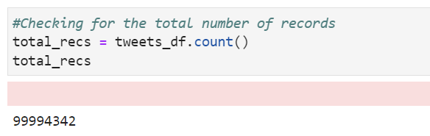
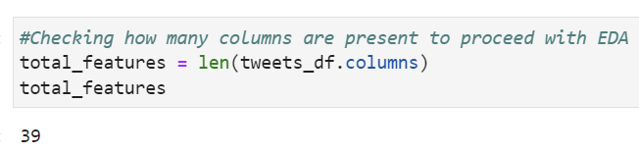
Source Data Overview
Data Source:
Google Cloud Storage Bucket (gs://msca-bdp-tweets/final_project)
Total Number of Records/ Tweets (~ 100 Million = 99,994,342)
Total Features/ Columns (39)
Executive Summary
Methodology
Source Data Overview
EDA
Analysis
Credibility
Conclusion

Slide 6

Data Filtration and Cleaning
Starting with data clean-up, I used some top education-related keywords to get relevant tweets.
Also, following a reverse approach, I got rid of the irrelevant tags by excluding them from the dataset.
Using language filter, took English language tweets only for analysis.
Upon filtration, I arrived at relevant records of around ~1 Million tweets
Source Data
(~100 Million)
Language == “en”
English Tweets
Education-based Tweet
~ 1 Million (1,005,167)
Executive Summary
Methodology
Source Data Overview
EDA
Analysis
Credibility
Conclusion

Slide 7
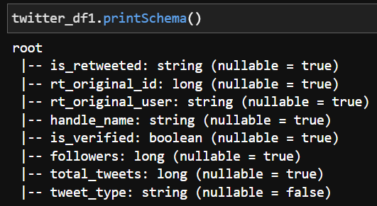
Exploratory Data Analysis
Based on the initial analyses, I observed there are many fields as per Tweet API that are empty and some basically were mostly null.
After filtering the data based on the need, I selected the columns that are required for my analyses and discarded the rest.
The columns/ fields of interest are user name, date of tweet creation, the location of the user, user description, retweeted status (is a retweet or not), and the tweet text
Executive Summary
Methodology
Source Data Overview
EDA
Analysis
Credibility
Conclusion
7

Slide 8
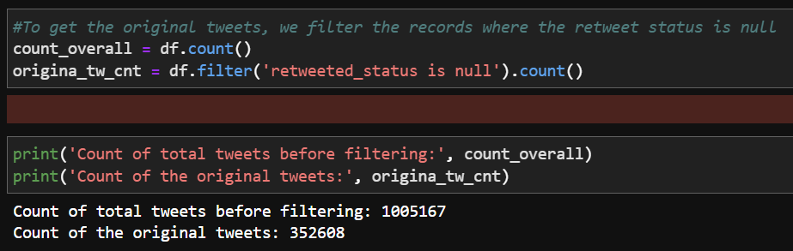
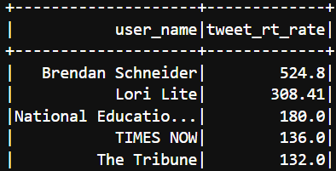
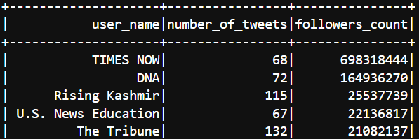
Author Identification Analysis
By checking for the original vs overall content in the tweets, it is fascinating to observe how the original tweets are only 30% of the whole
Based on the number of tweets, followers count and verified status, I could observe the most prolific and influential Twitterers are Times Now, DNA followed by Rising Kashmir
Based on the number of retweets, I calculated the retweet rate as (tweets count * average retweets) which helps us get the most influential twitterers
Brendan Schneider
Lori Lite
National Education Union
Executive Summary
Methodology
Source Data Overview
EDA
Analysis
Credibility
Conclusion
8

Slide 9
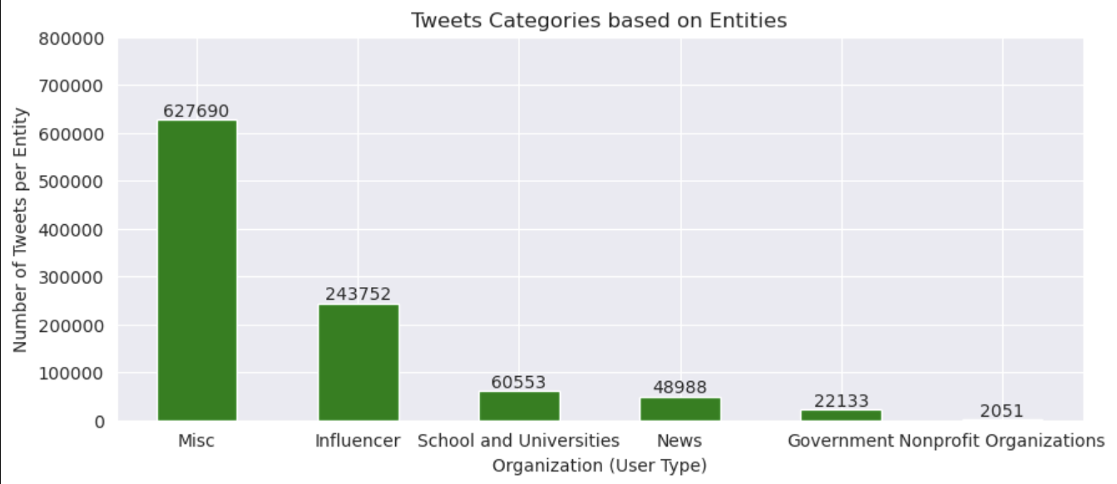
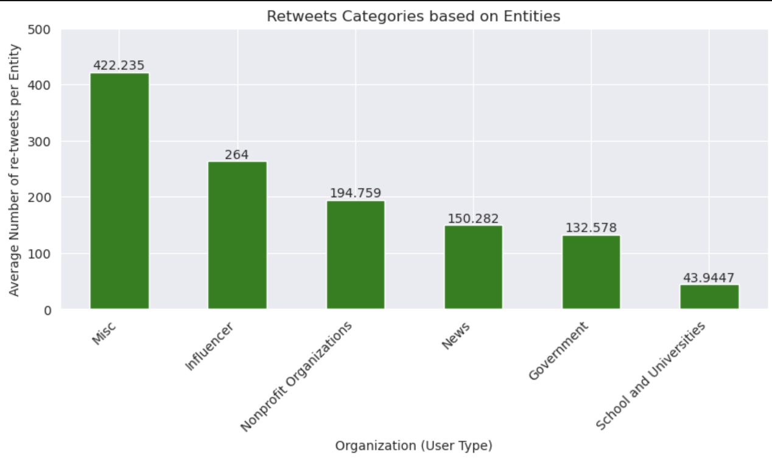
Entity Based Classification
It can be seen that the majority of the tweets (original) come from the Influencer entity, who in this new-age world, has more influential power, followed by the Schools and Universities
Since individual twitterers like us are many, the group of Misc (miscellaneous) shows the general public does share their opinions on education.
The average retweets are more from Influencers than any other entities. However, it was interesting to observe how the Non-profit organizations about education retweet more than tweeting
Executive Summary
Methodology
Source Data Overview
EDA
Analysis
Credibility
Conclusion
9

Slide 10
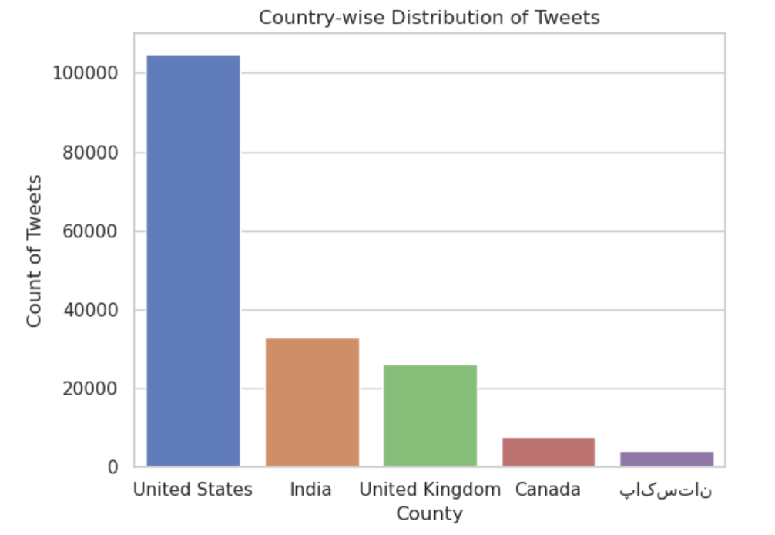
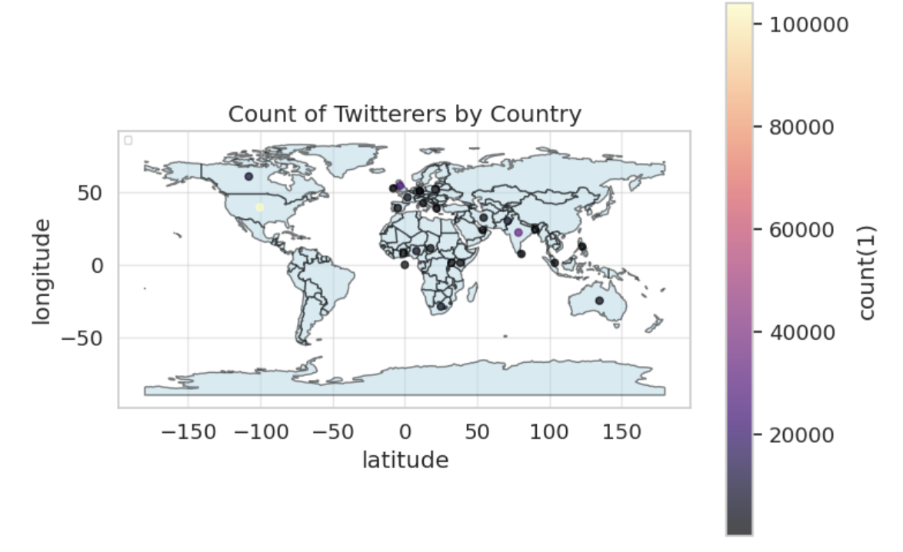
Geographical Analysis
India is second most by count
By using the user.location field and mapping them onto the location coordinates (using geocode), I plotted the heatmap as well distribution of the Twitter users from around the world.
It can be observed that most come from the United States, followed by India, and the UK stands third in this category.
Heat map helped me best visualize the concentration of twitterers
We can observe the majority of the tweets come from the US
Executive Summary
Methodology
Source Data Overview
EDA
Analysis
Credibility
Conclusion
10

Slide 11
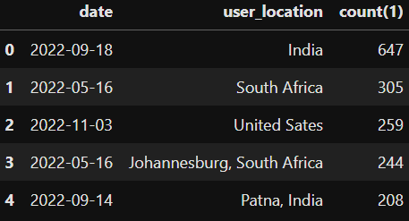
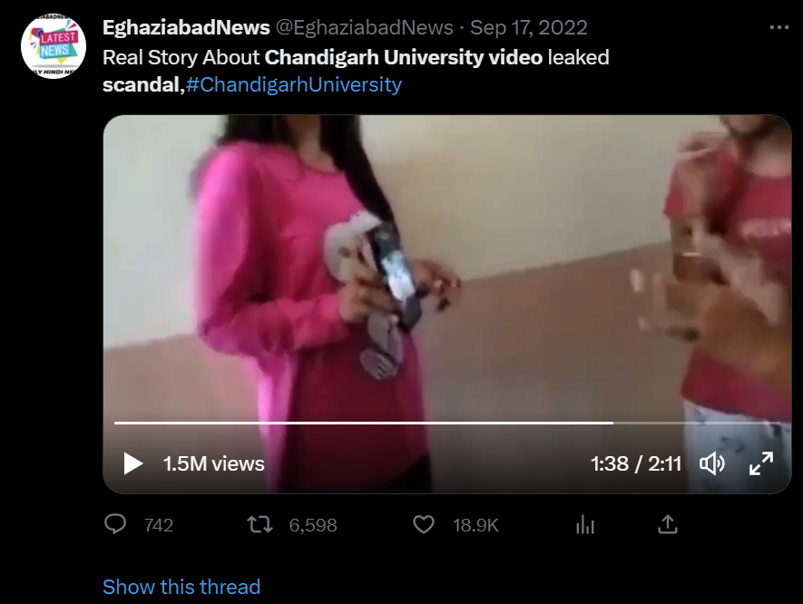
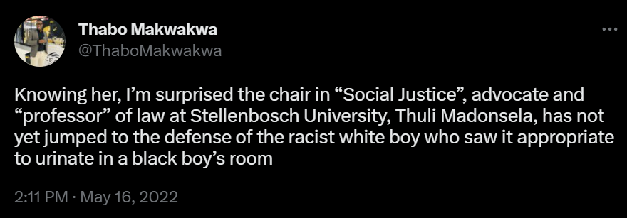
Topic Progression By Geographical Location
Based on the frequency of tweets,
I could see that there was trending news in India and South Africa on 2022/09/18 and 2022/05/16 respectively
Digging deeper, these are the topics that were trending on the respective days.
Leaked videos of women bathing, an alleged suicide, and protests: Chandigarh hostel MMS scandal explained
FP Explainers, September 19, 2022 09:44:24 IST
SA: Uni student who urinated on books and the laptop of a black student expelled
By Rédaction Africanews with AFP
Last updated: 22/07 - 16:34
Executive Summary
Methodology
Source Data Overview
EDA
Analysis
Credibility
Conclusion
11

Slide 12
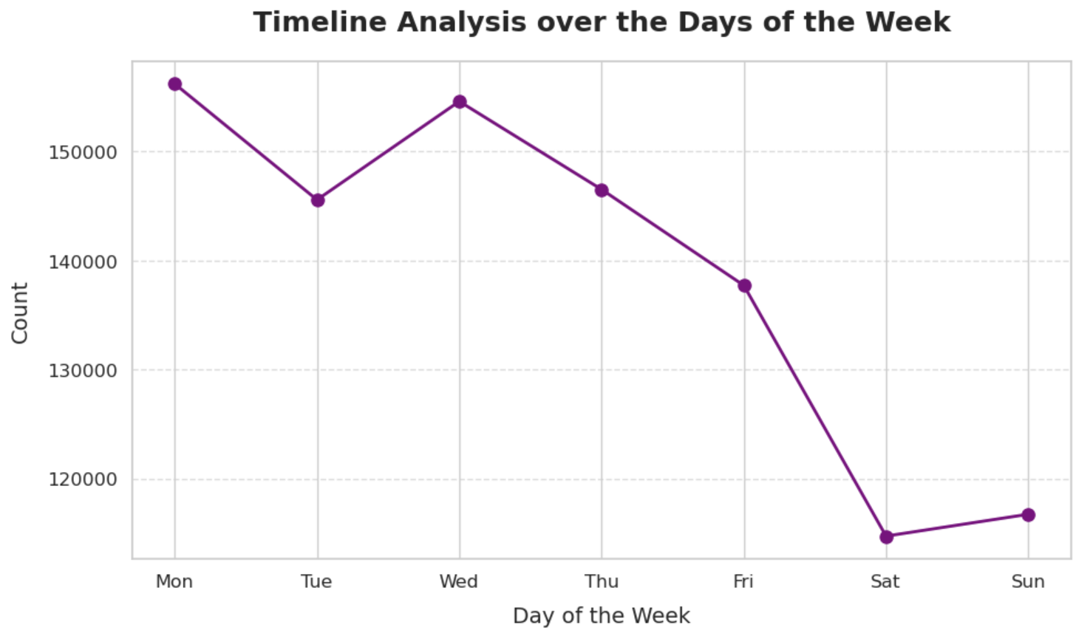
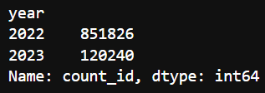
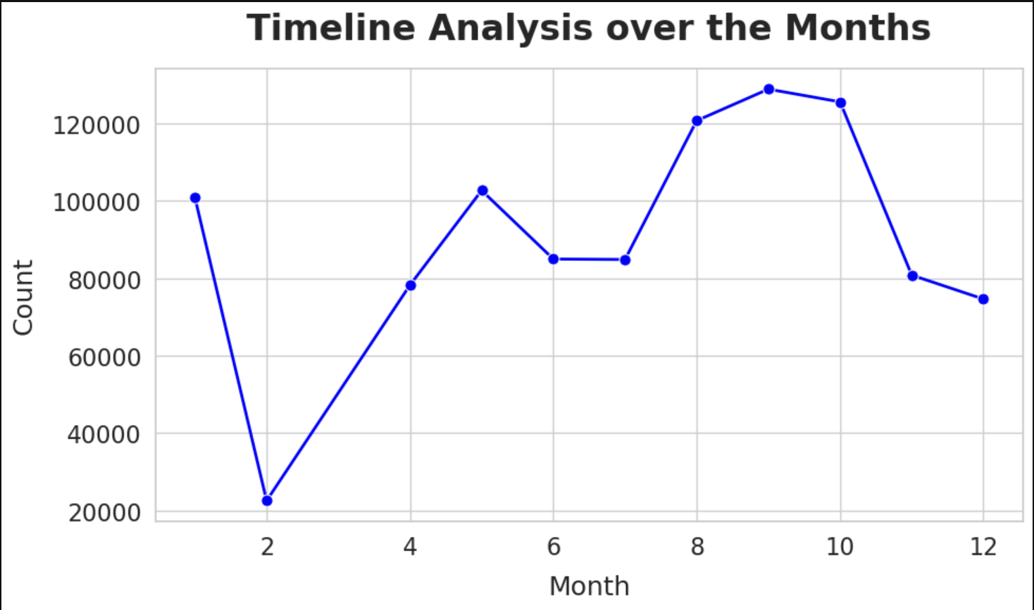
Timeline-based Analysis
The majority of the tweets are from 2022 and some are from 2023.
It is evident that education tweets are at a high number during the fall season owing to the beginning of a new school/ college year. Likewise, Mondays and Wednesdays see a rise in tweets at the start of the week for schools and then decline toward weekends (holidays)
The fall season sees a peak
Executive Summary
Methodology
Source Data Overview
EDA
Analysis
Credibility
Conclusion
12

Slide 13
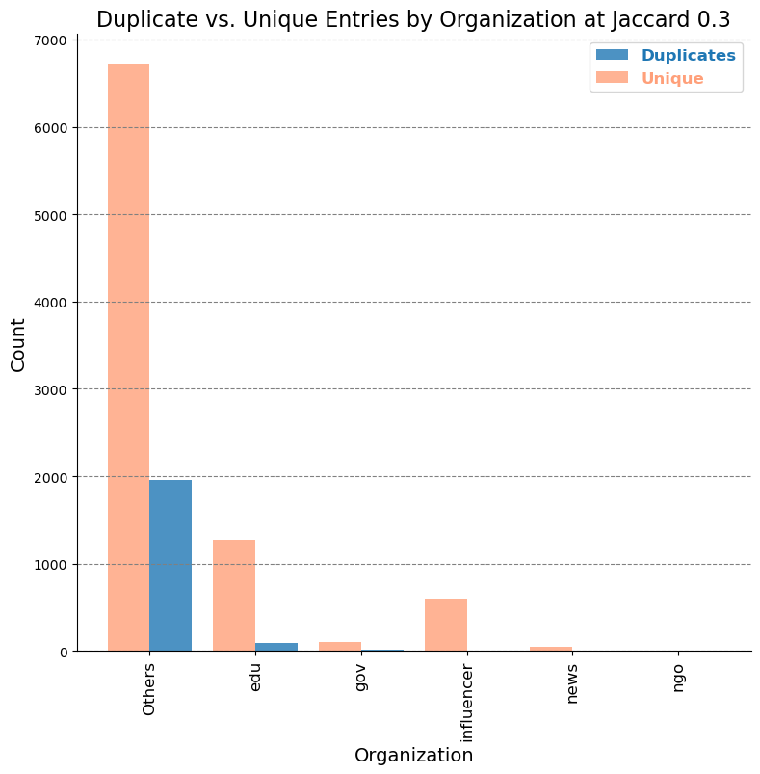
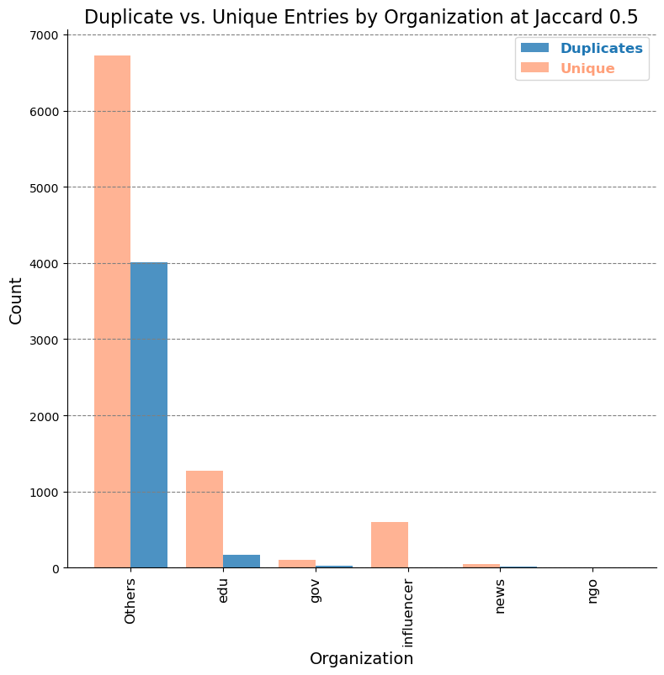
(Similarity Analysis) Twitter as a Credible Source
Analyzing the uniqueness of tweets on a sample of 10k records using the MinHashLSH algorithm, I could fairly distinguish between unique and duplicate tweets.
Government, Influencers, and News are the entities that have the least duplicates
At a Jaccard similarity of 0.3, I could observe that the duplicates are at ~ 2,000 which is 20% of the sample.
At Jaccard distance 0.5
Executive Summary
Methodology
Source Data Overview
EDA
Analysis
Credibility
Conclusion
13

Slide 14
Conclusion
Based on the analyses conducted, Twitter seems to be a credible source of information but at times can be misleading. However, it is always better to cross-check for credibility against news from top articles and other reliable sources.
Out of the ~100M records, after filtering based on requirement and reaching ~1M records, the observations are:
Influential/ Most Prolific Twitterers – Time Now based on original content and Brendan Schneider according to the retweet count
Geographical and Time analyses helped us understand that the US is where the major activity happens and that the fall season and the start of the week are where the most tweets are posted.
Out of the relevant ~1M records, drawing a sample of ~10,000 records, I could observe that ~20% of the tweets are duplicates. This goes to show that Twitter, after all, is a good source of information
Executive Summary
Methodology
Source Data Overview
EDA
Analysis
Credibility
Conclusion
14

Slide 15
Future Scope & Recommendations
The imbalance in the type of users on Twitter, the uncertainty of the verified status, and bot activity make Twitter lose its credibility as a reliable source of information
Twitter can be treated as a secondary source of information or go-to if there is no other way.
Raw data that we procured is noisy and has a lot of imbalance which could lead to bias in the analysis. Better to confirm with other sources.
However, these challenges can be overcome by certain data-driven actions:
Be aware of the Twitter handle the information is coming from, the follower count, the type of audience, the reply count, and other factors before trusting the piece of information.
Impersonation on Twitter is a major concern and a serious issue in the current AI world. Bot activity adds to this inconvenience.
15

Slide 16
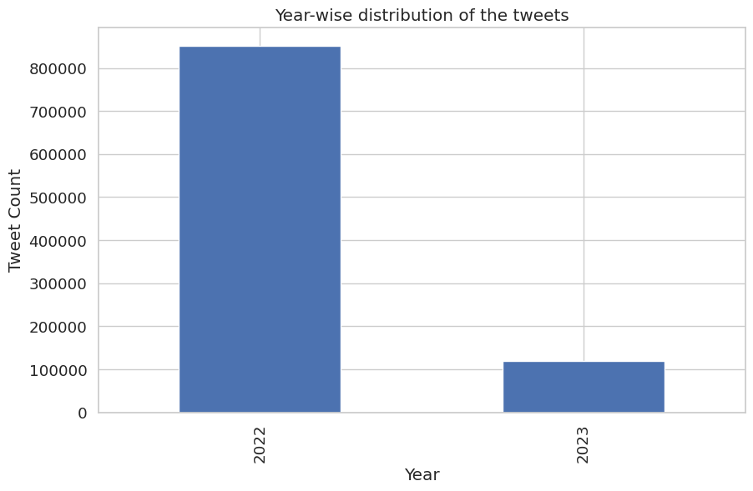
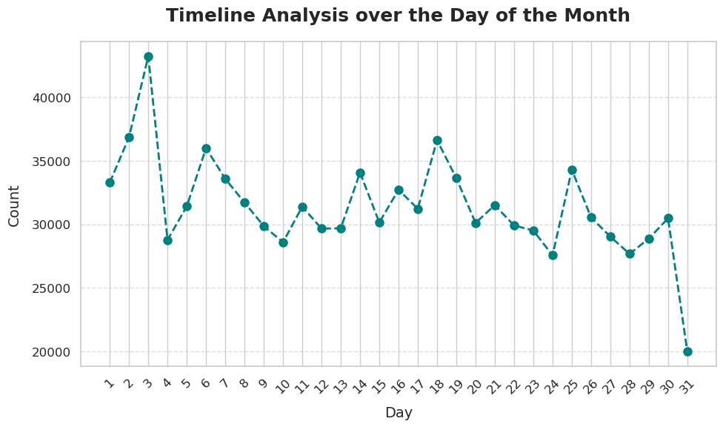
Appendix
Source data spans over two years
Over the month, we can see the behavior of the average twitterer regarding education
16

